Slide 1


AI PROJECT ON
End-to-End Text Summarization
Mentor :- Dr. Susham Biswas Submitted By:-Saumya Laddha

Slide 2
CONTENTS
1
2
3
4
5
INTRODUCTION
PROJECT-SUMMARY
WORKFLOW
DATA INGESTION
DATA VALIDATION
6
9
7
8
10
DATA TRANSFORMATION
IMPROVEMENTS
CONCLUSION
MODEL TRAINING
MODEL EVALUTION

Slide 3

PROJECT SUMMARY
This project focuses on leveraging the Pegasus CNN/Dailymail model from Hugging FaceTransformers for end-to-end text summarization, specifically targeting dialogues. Utilizing the SAMSum Corpus—a dataset of 16,000+ human-annotated chat dialogues—the project encompasses data ingestion, validation,tranformation. The objective is to train and evaluate the model for effective dialogue summarization, contributing to advancements in abstractive summarization within NLP.
DATA INFORMATION
Dataset: SAMSum Corpus
Source: Hugging Face
Description: A human-annotated dialogue dataset comprising 16k+ chat dialogues with manual summaries. It serves as a valuable resource for training and evaluating abstractive summarization models.
Citation: Gliwa, B., Mochol, I., Biesek, M., & Wawer, A. (2019). SAMSum Corpus: A Human-annotated Dialogue Dataset for Abstractive Summarization
Aileron

Slide 4
WORKFLOW
Update config.yaml |  | Update entity |  | Update configuration.py in src |  | Update Component |  | Update Pipline
The purpose of having a config.yaml file is to centralize and manage configuration options, making it easy to adjust various parameters without modifying the actual code |  | This data class is designed to provide a structured way to manage and pass configuration parameters specifically related to the evaluation of a machine learning model |  | The purpose of this ConfigurationManager class is to encapsulate the logic of reading configuration files, creating necessary directories, and providing different configuration objects for various components of an NLP pipeline |  | The purpose of these components is to create a modular and organized system for ingesting, validating, transforming, training, and evaluating models for text summarization using the Pegasus architecture |  | the purpose training pipelines is to facilitate the end-to-end training process for a text summarization system by sequentially executing data ingestion, validation, transformation, and model training tasks
Update main.py
main.py play a role in initiating the execution of the text summarization pipeline, coordinating the stages (e.g., data ingestion, validation, transformation, training, and evaluation), and ensuring that the application runs smoothly.
Poppins

Slide 5




DATA INGESTION
DATA INGESTION CLASS
The DataIngestion class is responsible for downloading a dataset from a specified URL and extracting it. It uses the requests library to handle HTTP requests and the zip file module for zip file extraction.
DOWNLOADING AND EXTRACTING DATA
Use visual charts to communicateThe download_file method checks if the data file already exists. If not, it downloads the file from the provided source URL. The extract_zip_file method then extracts the contents of the zip file.
CONFIGURATION
The configuration for data ingestion is defined in the config.py file under the data_ingestion section. This includes parameters such as the root directory, source URL, local data file path, and unzip directory

Slide 6

DATA VALIDATION
Configuration:
The DataValidation class is initialized with a DataValidationConfig object, containing settings such as the list of required files and the status file path.
File Existence Check:
The validate_all_files_exist method lists all files in the specified directory and checks if each file is in the list of required files.
Depending on the result, it sets the validation_status and writes it to the status file.

Slide 7

Efficiency: Efficient tokenization using Hugging Face Transformers library.
Responsibilities: Converts raw data into a format suitable for Pegasus model training
TOKENIZATION PROCESS
CLASS OVERVIEW
DATA TRANSFORMATION
Procedure: Converts dialogue and summary components into PyTorch-compatible features.
Parameters: Defined in DataTransformationConfig for easy management.
Dataset Conversion:
Configuration

Slide 8
TRAINING PROCESS:
Initialisation: Sets up model, tokenizer, and data collator. Loading Data: Utilizes a subset of the training dataset. Configuration: Leverages the Trainer for efficient training.
TRAINING STEPS
Training Steps: Model: Uses Pegasus for abstractive summarization. Tokenizer: Processes input with the chosen tokenizer. Data Collation: Prepares data for efficient training. Model Saving: Saves trained model and tokenizer for reusability.
MODEL OVERVIEW:
Architecture: Pegasus for seq-to-seq tasks. Abstractive Summarization: Designed for human-like summarise
MODEL TRAINING

Slide 9
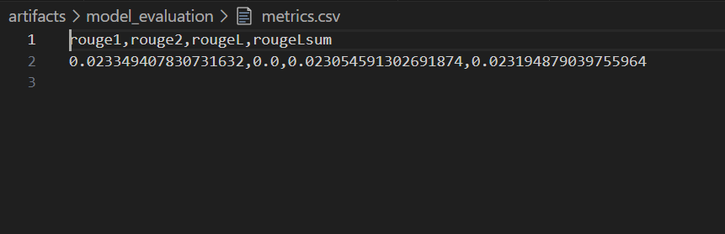
Model Performance Metrics: ROUGE Scores
ROUGE-1: 0.0233
ROUGE-L: 0.0231
ROUGE-Lsum: 0.0232
Evaluation Process
Calculated ROUGE scores using the Pegasus model on the test dataset.
Emphasized on precision in unigram overlap (ROUGE-1) and sentence-level overlap (ROUGE-L).
Observations
Notable performance in unigram overlap (ROUGE-1).
MODEL
EVALUATION
The Power of Visual Charts

Slide 10
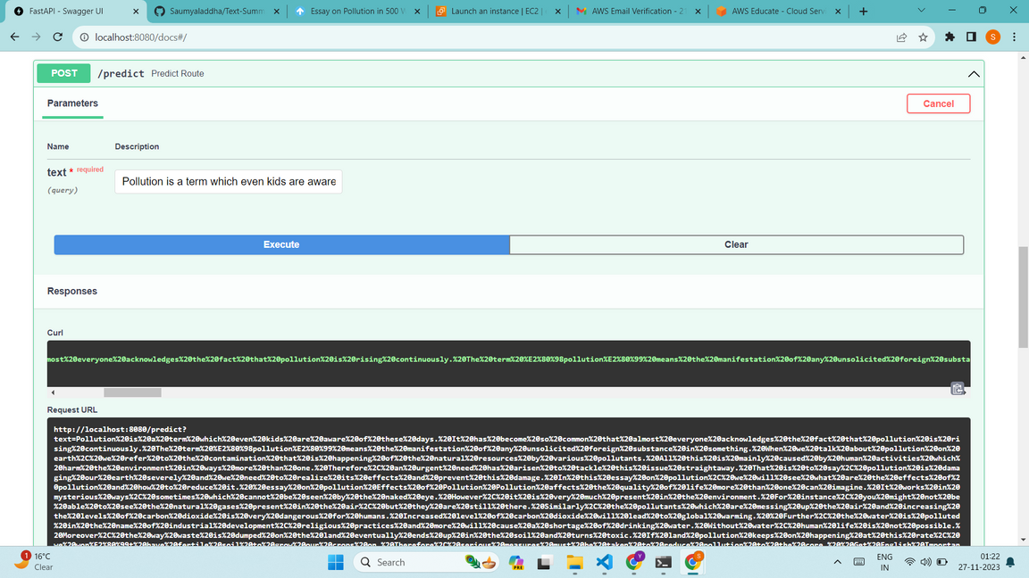
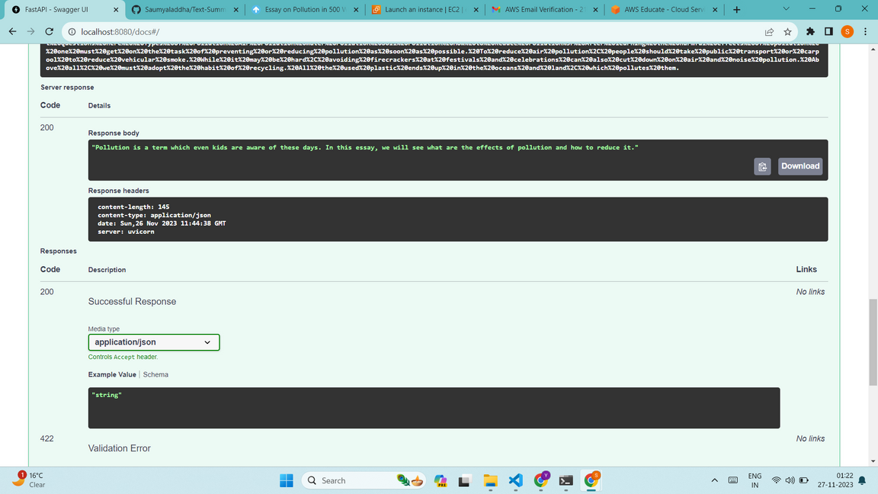
UI ADDED

Slide 11
Enhanced User Interaction: Implement interactive features in the web-based interface for user customization.
Larger Models: Explore larger transformers for potential performance gains.
IMPROVEMENTS
Data Augmentation:
Implement techniques for dataset diversification.
Translation Services: Explore integration with translation services for multilingual summarization
Grammar Checker: Integrate a grammar checking feature for improved output quality.

Slide 12

CONCLUSION
IN CONCLUSION, THE PROJECT DEMONSTRATES THE EFFICACY OF PEGASUS AND HUGGING FACE TRANSFORMERS IN DIALOGUE SUMMARIZATION. SPECIAL THANKS TO DR SUSHAM BISWAS FOR INVALUABLE GUIDANCE. NOTEWORTHY CHALLENGES INCLUDED PROLONGED TRAINING TIMES—APPROXIMATELY 4 DAYS—AND HURDLES IN AWS DEPLOYMENT DUE TO ASSOCIATED COSTS. LOOKING AHEAD, CRUCIAL ENHANCEMENTS INVOLVE INTEGRATING A GRAMMAR CHECKER, TRANSLATION SERVICES, AND RESOLVING AWS DEPLOYMENT CHALLENGES.

Slide 13
Thank You!

